Slide 1
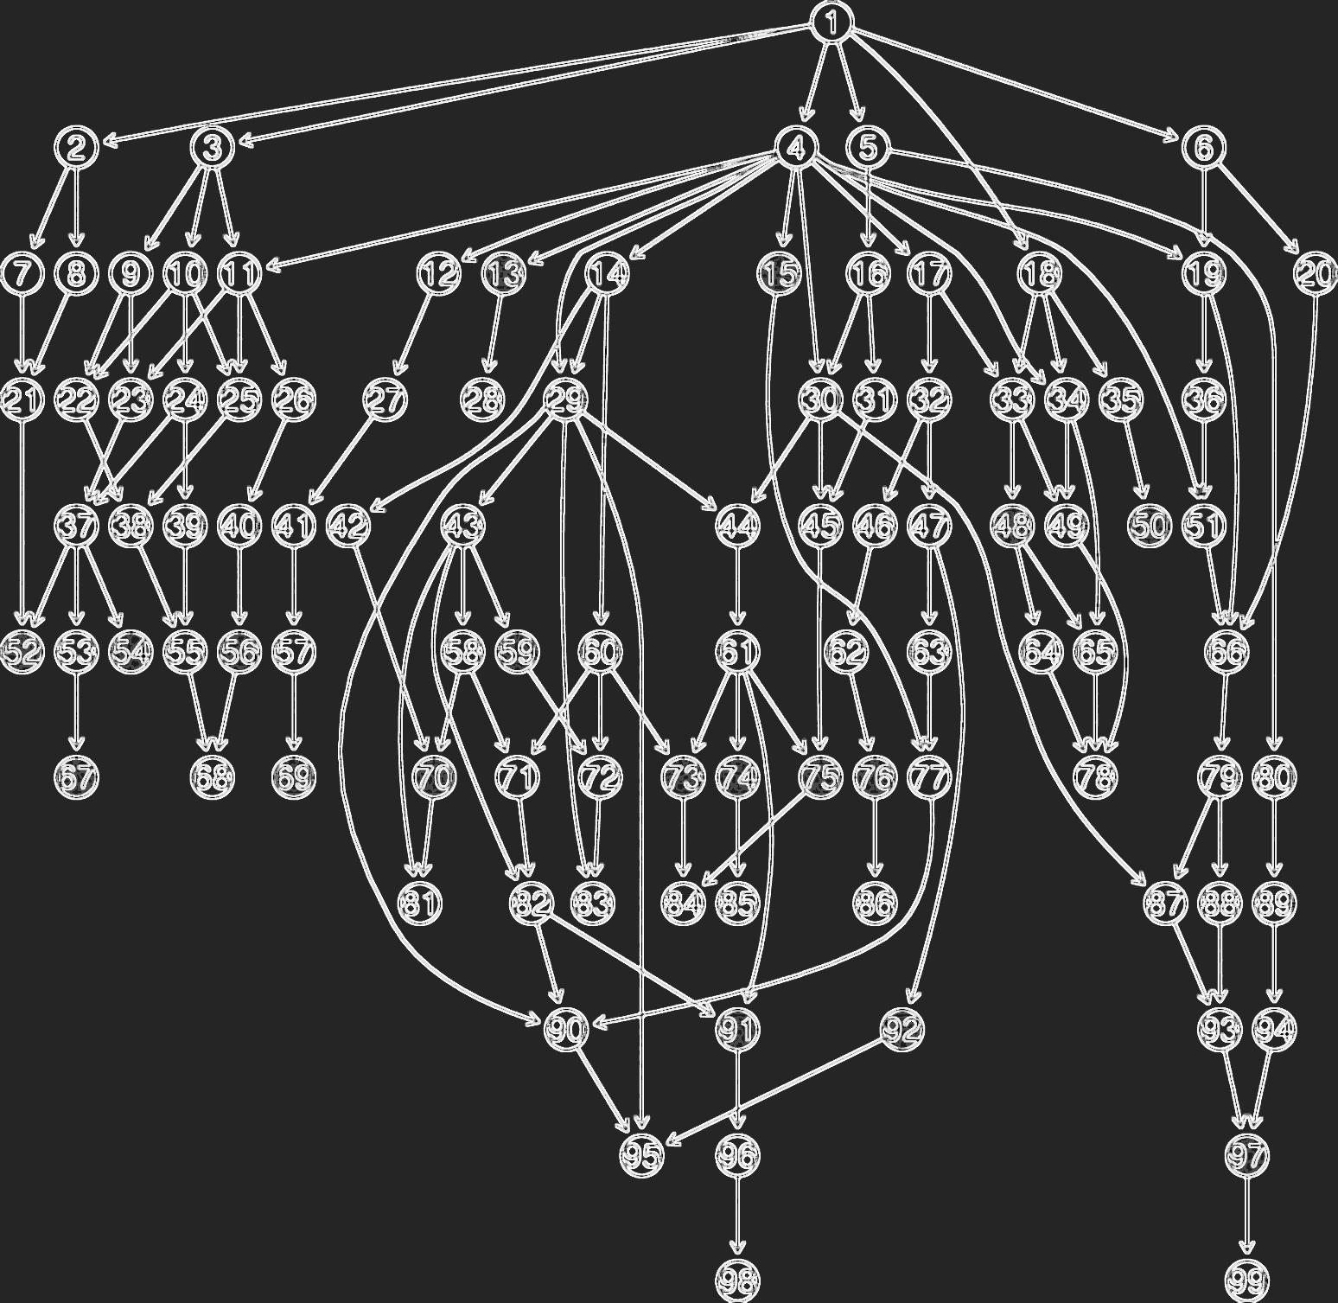
Curriculum Graph Visualizer
Dana Toribio
CPSC 589 Fall 2015
California State University, Fullerton
Notes:
Hi everyone. My name is Dana Toribio. This is my preliminary presentation for my graduate project, the Curriculum Graph Visualizer.

Slide 2
Agenda
Introduction
Objectives
Activities
Environment
Project
Schedule
References
Notes:
These will be the topics presented today.

Slide 3
Introduction
Key Issues
Problem Domain
Current Solutions
Problem Solution

Slide 4
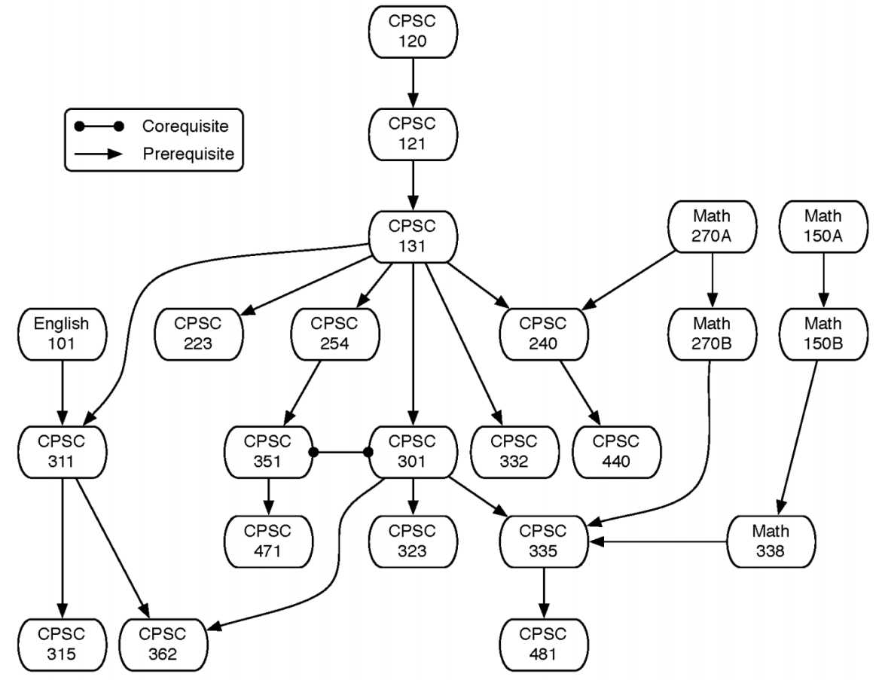
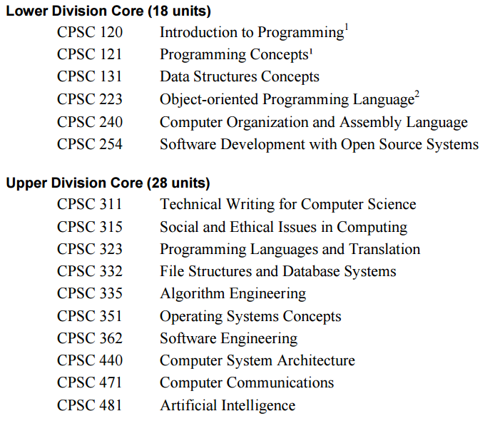
Key Issues
The graph of courses and their prerequisites is complex, and students and faculty can both struggle to visualize it.
Image Sources:
CSUF 2014 Computer Science Curriculum Graph: http://www.fullerton.edu/ecs/cs/docs/Undergraduate%20Handbook%20-%20Fall%202014Revised.pdf
Notes:
As students, we’ve worked with course curriculums, a list of courses we need to complete in order to receive a degree.
Listed here is the core curriculum for CSUF’s undergraduate computer science major.
What it doesn’t help us with is visualizing and understanding the relationship between all the courses.
So here, we have the graphical presentation of the course curriculum, also known as a curriculum graph.
Paired with the course list, the curriculum graph gives a better understanding of the course progression.
This brings us to the problem at hand --
The graph of courses and their prerequisites is complex, and students and faculty can both struggle to visualize it.

Slide 5
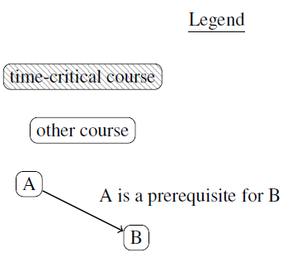
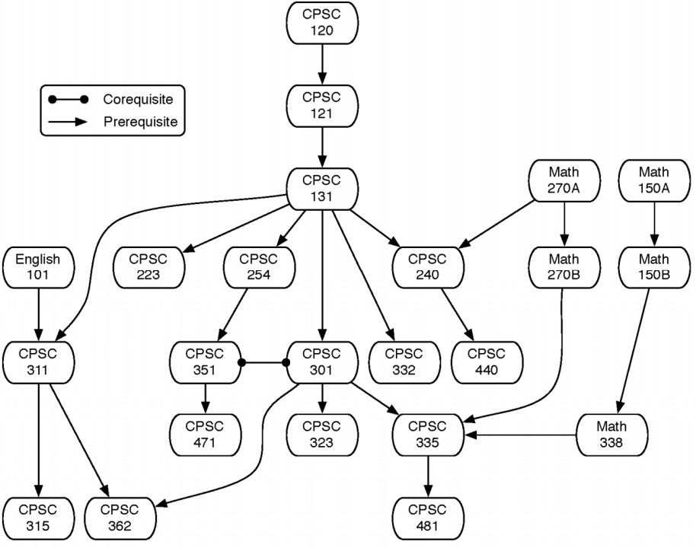
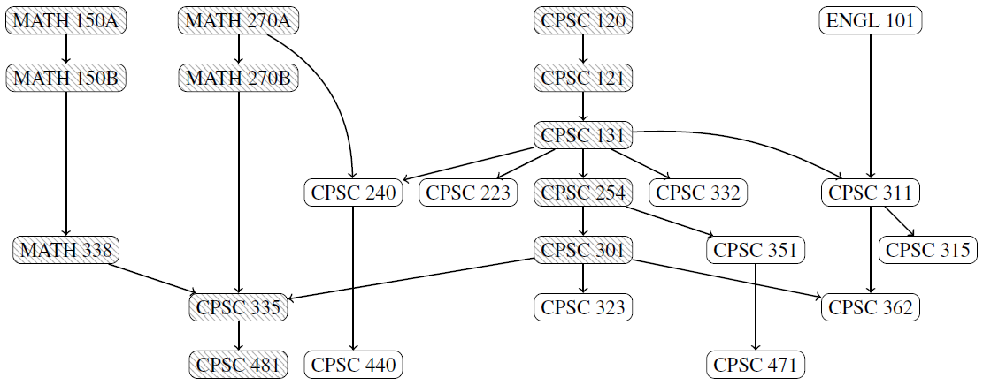
Key Issues
The graph of courses and their prerequisites is complex, and students and faculty can both struggle to visualize it.
Previous Curriculum Graph
Current Curriculum Graph
Image Sources:
CSUF 2014 Computer Science Curriculum Graph: http://www.fullerton.edu/ecs/cs/docs/Undergraduate%20Handbook%20-%20Fall%202014Revised.pdf
CSUF 2015 Computer Science Curriculum Graph: https://github.com/kevinwortman/CSUF-CPSC-handbooks/raw/master/Undergraduate_Handbook/CPSC_undergraduate_handbook.pdf

Slide 6
Problem Domain
Area of Expertise | Research Required
Fundamental Graph Algorithms | Hierachical, planar, general
Graph Drawing | NP-complete problem Requires computationally complete languages
Human Computer Interfaces (HCI) | Functionality, Ease of Use, Cross-compatibility
Potentially AI planning algorithms | For optimization and prediction (later iterations)
Notes:
Now, we have our problem statement, which is an end-user problem.
A potential solution is to model the curriculum as a directed graph, where each course is a vertex and each prerequisite requirement is a directed edge.
Going backwards into development, there are a few issues related to graph visualization.
It uses fundamental graph algorithms
Graph drawing is actually an NP-complete problem which requires computationally complete languages
Human Computer Interfaces or HCI another problem to consider like functionality, ease of use, cross-compatibility
It may potentially require artificial intelligence planning algorithms for predicting curriculums

Slide 7
Current Solutions
Database Models
Graph Databases
Digital Formats
Relational
Object-Oriented
Graph/Graphical
Neo4J
MongoDB
TinkerPop3
DOT
NetworkX
Gremlin
DOODLE
Notes:
For current methods to help me understand how to solve the problem, I will be going over:
Database Models
Specifically Graph Databases
and Digital Formats that will aid in graph programming

Slide 8
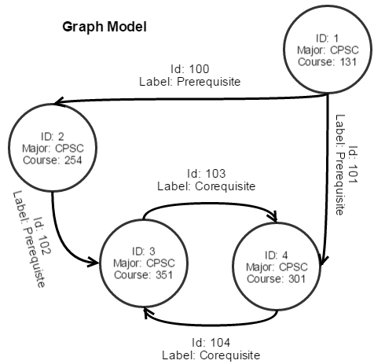
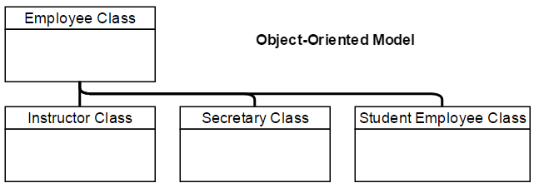
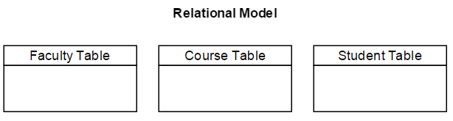
Current Solutions
Database Models
Relational | Most popular database model Limitations for graph programming
Object-Oriented | Deprecated/obsolete (1990s)
Graphical | Uses nodes, properties and edges New technology (2010s)
Notes:
The current methods for Database Models related to graph programming include
Relational Databases: It’s the most popular, but it has known limitations for graph programming
Object-oriented model: Used in a graphing program called DOODLE
Graph Model: Uses nodes, properties and edges
The graph shows CSUF curriculum graph in a graph model
The most unique part of the graph model is that the edges can be identified and labeled, which is useful with creating directed graphs
Old Notes:
Database Models
Graphical Databases complex; new technology
Relational Databases limitations for graph programming
Object-oriented Databases deprecated/obsolete?
Graphing Algorithms
Hierarchical
Planar
General Graphs

Slide 9
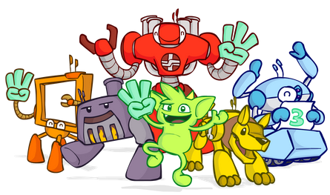
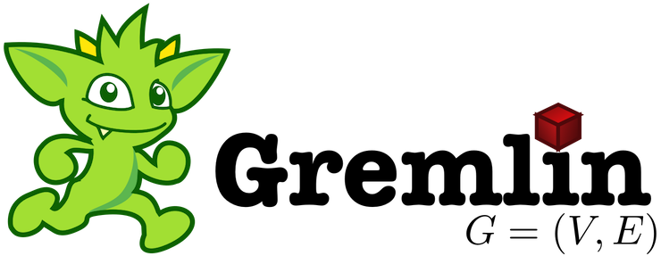
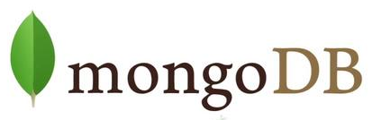


Current Solutions
Graph Databases
Neo4J | Java | Popular, Open-source, Property Graph model
MongoDB | Python | Document-oriented database, NoSQL
TinkerPop3 | Python, JavaScript, Java, Scala, PHP | Provides graph computing for graph DBs, Gremlin
Notes:
Some current methods in graph databases include:
Neo4J: It’s a very popular open-source property graph model that is implemented in Java
mongoDB: Uses NoSQL, a document-oriented database implemented in Python and is usable in virtual web applications
TinkerPop3: Can be used in a wide array of web programming languages and functional programming like Scala
TinkerPop3 utilizes Gremlin, which is of great interest for my research
Old Notes:
Database Models
Graphical Databases complex; new technology
Neo4J Java
MongoDB (NoSQL) Python
TinkerPop3 Python, JavaScript, Java, Scala, PHP
Relational Databases limitations for graph programming
Object-oriented Databases deprecated/obsolete?

Slide 10
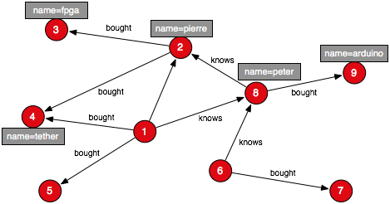
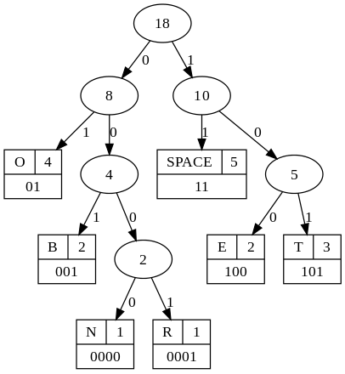
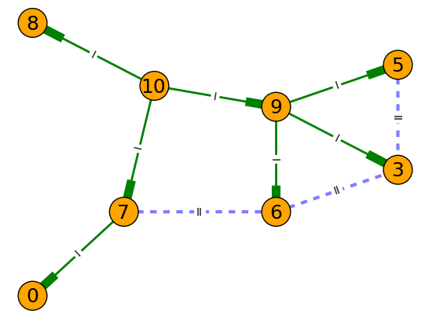
Current Solutions
Gremlin
via GraphML
Digital Formats
DOT | Plain text graph description language
NetworkX | Python library
Gremlin | Graph traversal language & VM
DOODLE | Object-oriented databases
DOT
via GraphViz
Current Solutions
NetworkX
Image Sources:
DOT: https://en.wikipedia.org/wiki/DOT_(graph_description_language)
NetworkX: http://guitarpenguin.is-programmer.com/posts/44818.html
Gremlin: http://markorodriguez.com/2011/06/15/graph-pattern-matching-with-gremlin-1-1/
Notes:
Now for the fun part – current methods in visual languages.
The first two languages recommended to me by Dr. Wortman include DOT and NetworkX.
DOT is a plain text graph description language.
The DOT language defines a graph, but needs external programs to render the DOT language.
This example shows a binary search tree generated with GraphViz
Next is NetworkX, a Python library for studying graphs and networks
This example shows a directed graph using NetworkX
Directed edges are represented with the solid rectangle
Gremlin is a graph traversal language and virtual machine
This is a graph created using Gremlin language and visually formatted in GraphML.
Gremlin is also used in the TinkerPop3 database
Database Models
Graphical Databases complex; new technology
Neo4J Java
MongoDB (NoSQL) Python
TinkerPop3 Python, JavaScript, Java, Scala, PHP
Relational Databases limitations for graph programming
Object-oriented Databases deprecated/obsolete?
Graphing Algorithms
Hierarchical
Planar
General Graphs
Visual Languages
DOT plain text graph description language
NetworkX python
DOODLE OO databases
G+
VQL
Gremlin

Slide 11
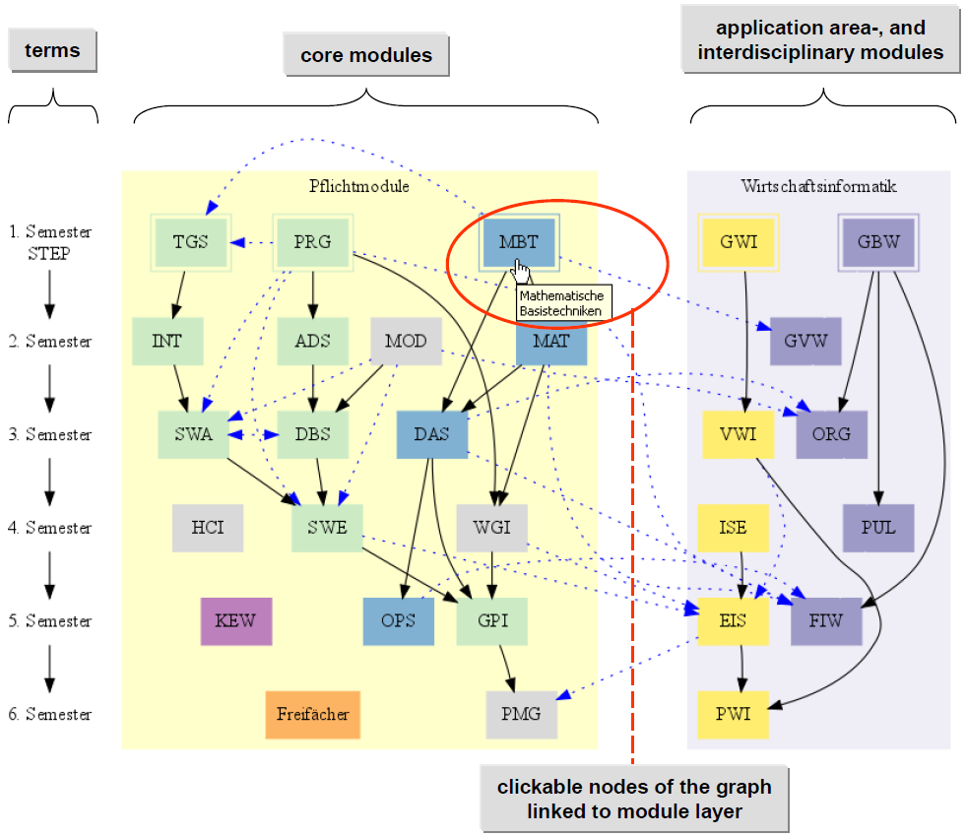
Current Solutions
ActiveCC
Wiki-supported Graph Visualization
Three layers
Curriculum
Module
Course
University of Vienna, Austria

Slide 12
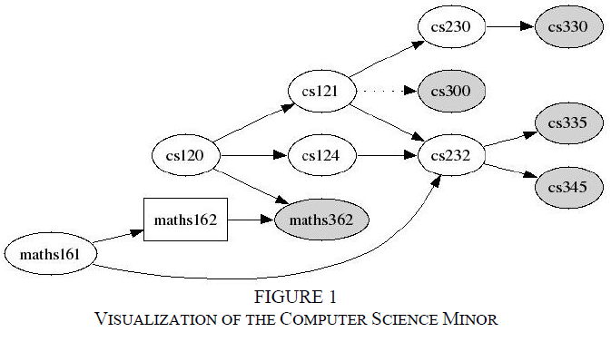
Current Solutions
CurricVis
Prototype used to generation visualizations of Computer Science curricula
Implemented in SWI-Prolog
Three-tier software architecture
Knowledge Base
Visualization Generation
User Interface
Ball University, Indiana, USA

Slide 13
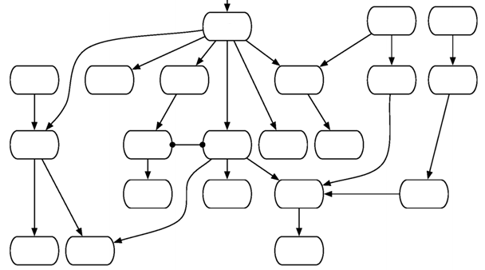
Problem Solution
Model the curriculum as a directed graph
Each course is a vertex
Each prerequisite is a directed edge
I/O
Input: Curriculum graph data with locations
Output: Graph drawings

Slide 14
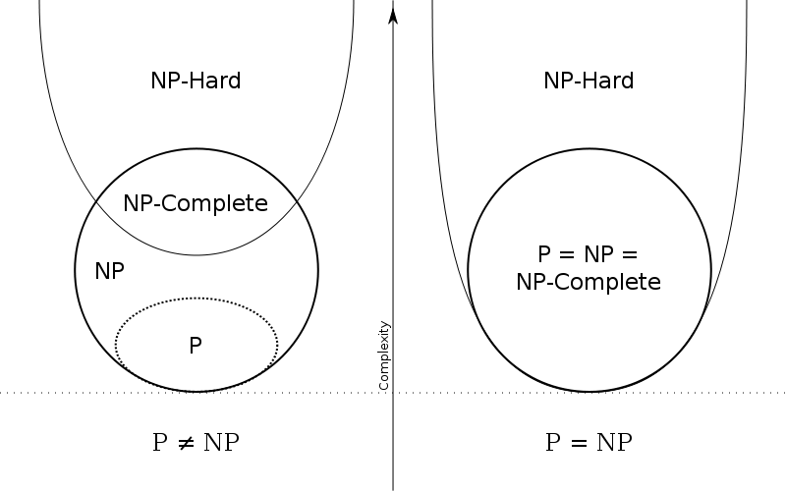
Challenges
Complexity
NP-complete problem
Algorithm selection
Graph Drawing
Crossed edges
Image Sources:
Euler Diagram of NP-completeness: https://en.wikipedia.org/wiki/NP-completeness
CSUF 2015 Computer Science Curriculum Graph: https://github.com/kevinwortman/CSUF-CPSC-handbooks/raw/master/Undergraduate_Handbook/CPSC_undergraduate_handbook.pdf

Slide 15
Objectives
Graph drawing
Minimize overlapping edges
Organize graph into strata
Organize graph into tracks
Indicate completed courses
Web application
Image Sources:
CSUF 2015 Computer Science Curriculum Graph: https://github.com/kevinwortman/CSUF-CPSC-handbooks/raw/master/Undergraduate_Handbook/CPSC_undergraduate_handbook.pdf

Slide 16
Activities
Phase 1 – Algorithms
Phase 2 – Development
Algorithm Discovery
Algorithm Testing
Deliverable
Algorithm Design Document
Deliverable
Project

Slide 17
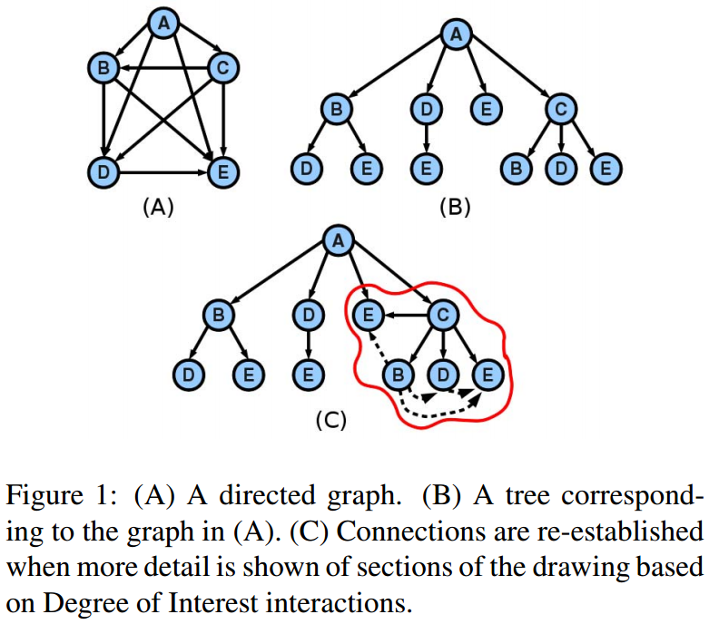
Phase 1 – Algorithm
PieVis
Algorithm Discovery
Exhaustive Search
Greedy Algorithm
Top-Down FastRings Tree Drawing Algorithm^{[8]}
Bottom-up RINGS Algorithm^{[8]}
Depth-first Search Algorithms
Groupoid, Greedoids, Matroids
Solution via simulation of NP-completeness
Image Sources
Digraph drawing: [8]

Slide 18
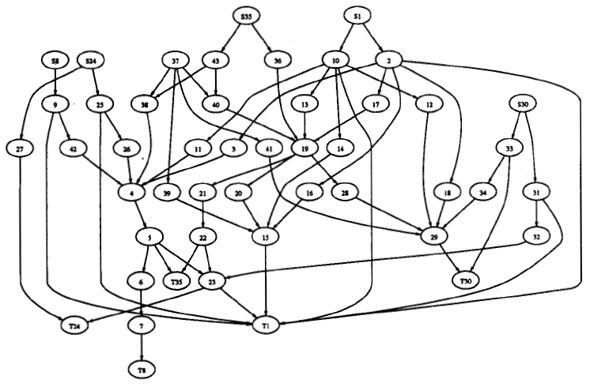
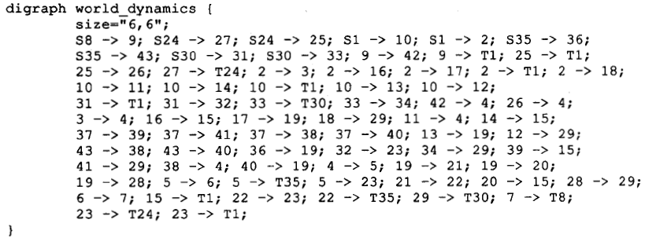
Phase 1 – Algorithm
Algorithm Discovery
Subject: Digraph Drawing
Problem: Edge crossing reduction [6]
Studied by Warfield
Other methods discovered by
Carpano
Sugiyama, Tagawa and Toda
Image Sources
Digraph drawing: [6]

Slide 19
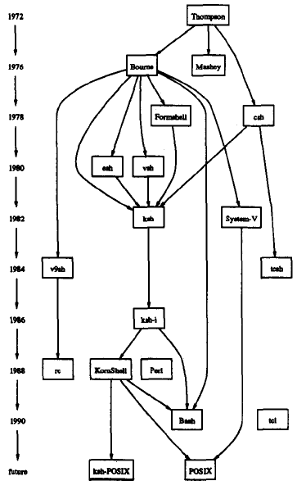
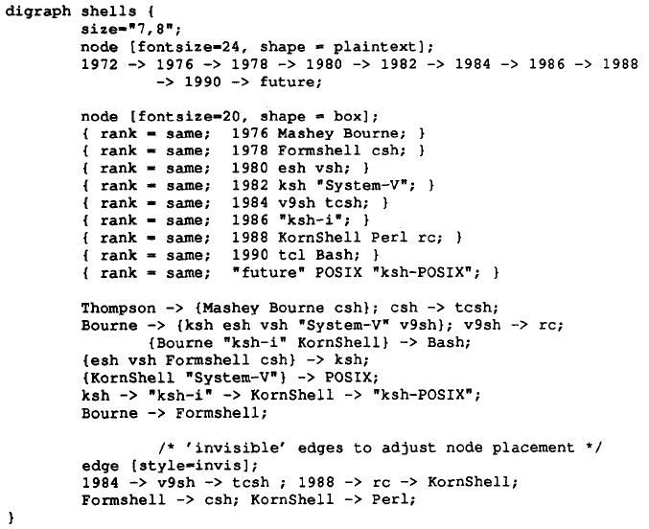
Phase 1 – Algorithm
Algorithm Discovery
Subject: Strata Organization
Possibly related to Optimal Rank Assignment [6]
Image Sources
Digraph drawing: [6]

Slide 20
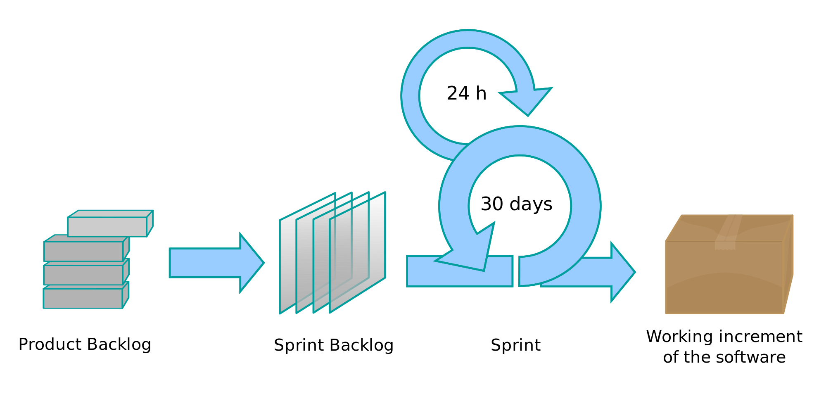
Phase 2 – Development
Development Process
AGILE/SCRUM
Monthly Iterations
Project Deliverable
Image Sources
The SCRUM Process: https://en.wikipedia.org/wiki/Scrum_(software_development)

Slide 21
Environment
Hardware | CPU: Intel Core i5-3570K 3.4GHz Motherboard: ASRock Extreme4 LGA 1155 Intel Z77 GPU: PNY NVIDIA GeForce 560 Ti Fermi 1GB SSD: SAMSUNG 830 Series 2.5" 128GB SSD HDD: Seagate Barracuda 3TB SATA 6.0Gb/s HDD PSU: CORSAIR CX600 V2 600W ATX12V v2.3
OS | Windows 10
IDE | Sublime Text 3
Framework(s) | Bootstrap, Django
Programming Language(s) | Python, DOTS
Web Language(s) | HTML, CSS, JavaScript
Databases | TBD
Version Control | Git, GitHub
Python
DOTS
HTML/CSS
Bootstrap
Django

Slide 22
Project
Final Products
Algorithm Design Document
Web Application
Demonstration
Successfully draw curriculum graph
Minimize crossed edges
Organization
Organize into strata (by semester or year)
Categorize columns into tracks
Indicate completed courses

Slide 23
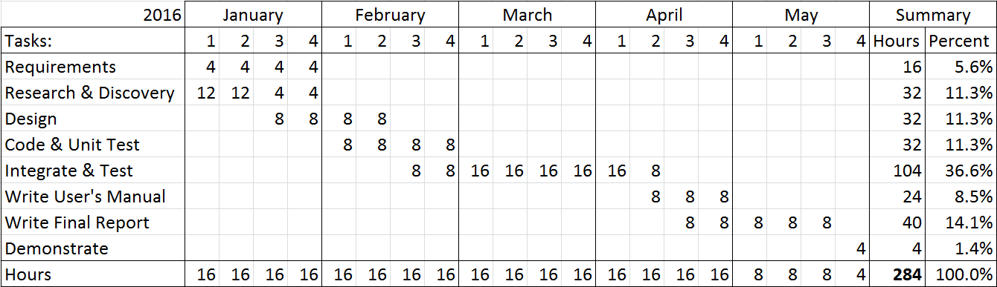
Schedule
Preliminary Requirements Gathering (June 2015 thru October 2015) = 8 hours

Slide 24
Acknowledgement
I would like to thank my mentors for guidance in the proposal process as well as our future collaboration in the upcoming semester for the completion of this project.
Dr. Kevin Wortman (Graduate Advisor)
Dr. Kent Palmer (Graduate Reviewer)
Dr. Kenneth Kung (Graduate Seminar Instructor)

Slide 25
References – Academic
Agrawal, V.K.; Earnest, J.; Gupta, S.K.; Tegar, J.P.; Mathew, S.S., "Outcome based engineering diploma curriculum - 2012 Gujarat experiment," in Frontiers in Education Conference, 2013 IEEE , vol., no., pp.1864-1870, 23-26 Oct. 2013
Azlan, A.; Hussin, N.M., "Implementing graph coloring heuristic in construction phase of curriculum-based course timetabling problem," in Computers & Informatics (ISCI), 2013 IEEE Symposium on , vol., no., pp.25-29, 7-9 April 2013Initial Positioning Method for Online and Real-Time Dynamic Graph Drawing of Time Varying Data
Gansner, E.R.; Koutsofios E.; North S.C.; Vo K., “A Technique for Drawing Directed Graphs,” in IEEE Transactions on Software Engineering, 1993, vol. 19, no. 3, pp. 214 -230, March 1993
Gestwicki, P., "Work in progress - curriculum visualization," in Frontiers in Education Conference, 2008. FIE 2008. 38th Annual , vol., no., pp.T3E-13-T3E-14, 22-25 Oct. 2008
Hosobe, H., "Analysis of a high-dimensional approach to interactive graph drawing," in Visualization, 2007. APVIS '07. 2007 6th International Asia-Pacific Symposium on , vol., no., pp.93-96, 5-7 Feb. 2007Coordinating Curriculum Implementation Using Wiki-supported Graph Visualization
McCreary, C.L.; Chapman, R.O.; Shieh, F.-S., "Using graph parsing for automatic graph drawing," in Systems, Man and Cybernetics, Part A: Systems and Humans, IEEE Transactions on , vol.28, no.5, pp.545-561, Sep 1998
Rodgers, P.J., "A graph rewriting programming language for graph drawing," in Visual Languages, 1998. Proceedings. 1998 IEEE Symposium on , vol., no., pp.32-39, 1-4 Sep 1998A Technique for Drawing Directed Graphs.
Rusu, A.; Crowell, A.; Petzinger, Bryan; Fabian, A., "PieVis: Interactive Graph Visualization Using a Rings-Based Tree Drawing Algorithm for Children and Crust Display for Parents," in Information Visualisation (IV), 2011 15th International Conference on, vol., no., pp.465-470, 13-15 July 2011
Slim, A.; Heileman, G.L.; Kozlick, J.; Abdallah, C.T., "Employing Markov Networks on Curriculum Graphs to Predict Student Performance," in Machine Learning and Applications (ICMLA), 2014 13th International Conference on , vol., no., pp.415-418, 3-6 Dec. 2014

Slide 26
References – Other
DOT (graph description language). (2015, September 15). Retrieved September 24, 2015, from https://en.wikipedia.org/wiki/DOT_(graph_description_language)
Hogg, A. (2013, August 1). Whiteboard it – the power of graph databases. Retrieved September 24, 2015, from http://www.computerweekly.com/feature/Whiteboard-it-the-power-of-graph-databases
Neubauer, P. (2010, May 10). Graph Databases, NOSQL and Neo4j. Retrieved September 20, 2015, from http://www.infoq.com/articles/graph-nosql-neo4j
Rodriguez, M. (2011, June 15). Graph Pattern Matching with Gremlin 1.1. Retrieved September 24, 2015, from http://markorodriguez.com/2011/06/15/graph-pattern-matching-with-gremlin-1-1/

Slide 27
Q & A
Thank you!

Slide 28
Curriculum Graph Visualizer
Dana Toribio
CPSC 589 Fall 2015
California State University, Fullerton
Notes:
Hi everyone. My name is Dana Toribio. This is my preliminary presentation for my graduate project, the Curriculum Graph Visualizer.

Slide 29
Agenda
Introduction
Problem Statement
Current Methods
Proposed System
Research Significance
Next Steps
References
Notes:
These will be the topics presented today.

Slide 30
Introduction
The graph of courses and their prerequisites is complex, and students and faculty can both struggle to visualize it.
Notes:
As students, we’ve worked with course curriculums, a list of courses we need to complete in order to receive a degree.
Listed here is the core curriculum for CSUF’s undergraduate computer science major.
What it doesn’t help us with is visualizing and understanding the relationship between all the courses.
So here, we have the graphical presentation of the course curriculum, also known as a curriculum graph.
Paired with the course list, the curriculum graph gives a better understanding of the course progression.
This brings us to the problem at hand --
The graph of courses and their prerequisites is complex, and students and faculty can both struggle to visualize it.

Slide 31
Problem Statement
The graph of courses and their prerequisites is complex, and students and faculty can both struggle to visualize it.
Potential Solution
Model the curriculum as a directed graph
Each course is a vertex
Each prerequisite is a directed edge
Development Problems
Fundamental Graph Algorithms | Hierachical, planar, general
Graph Drawing | NP-complete problem Requires computationally complete languages
Human Computer Interfaces (HCI) | Functionality, Ease of Use, Cross-compatibility
Potentially AI planning algorithms | For optimization and prediction (later iterations)
Notes:
Now, we have our problem statement, which is an end-user problem.
A potential solution is to model the curriculum as a directed graph, where each course is a vertex and each prerequisite requirement is a directed edge.
Going backwards into development, there are a few issues related to graph visualization.
It uses fundamental graph algorithms
Graph drawing is actually an NP-complete problem which requires computationally complete languages
Human Computer Interfaces or HCI another problem to consider like functionality, ease of use, cross-compatibility
It may potentially require artificial intelligence planning algorithms for predicting curriculums

Slide 32
Current Methods
Database Models
Graph Databases
Digital Formats
Relational
Object-Oriented
Graph/Graphical
Neo4J
MongoDB
TinkerPop3
DOT
NetworkX
Gremlin
DOODLE
Notes:
For current methods to help me understand how to solve the problem, I will be going over:
Database Models
Specifically Graph Databases
and Digital Formats that will aid in graph programming

Slide 33
Current Methods
Database Models
Relational | Most popular database model Limitations for graph programming
Object-Oriented | Deprecated/obsolete (1990s)
Graphical | Uses nodes, properties and edges New technology (2010s)
Notes:
The current methods for Database Models related to graph programming include
Relational Databases: It’s the most popular, but it has known limitations for graph programming
Object-oriented model: Used in a graphing program called DOODLE
Graph Model: Uses nodes, properties and edges
The graph shows CSUF curriculum graph in a graph model
The most unique part of the graph model is that the edges can be identified and labeled, which is useful with creating directed graphs
Old Notes:
Database Models
Graphical Databases complex; new technology
Relational Databases limitations for graph programming
Object-oriented Databases deprecated/obsolete?
Graphing Algorithms
Hierarchical
Planar
General Graphs

Slide 34
Current Methods
Graph Databases
Neo4J | Java | Popular, Open-source, Property Graph model
MongoDB | Python | Document-oriented database, NoSQL
TinkerPop3 | Python, JavaScript, Java, Scala, PHP | Provides graph computing for graph DBs, Gremlin
Notes:
Some current methods in graph databases include:
Neo4J: It’s a very popular open-source property graph model that is implemented in Java
mongoDB: Uses NoSQL, a document-oriented database implemented in Python and is usable in virtual web applications
TinkerPop3: Can be used in a wide array of web programming languages and functional programming like Scala
TinkerPop3 utilizes Gremlin, which is of great interest for my research
Old Notes:
Database Models
Graphical Databases complex; new technology
Neo4J Java
MongoDB (NoSQL) Python
TinkerPop3 Python, JavaScript, Java, Scala, PHP
Relational Databases limitations for graph programming
Object-oriented Databases deprecated/obsolete?

Slide 35
Current Methods
Gremlin
via GraphML
Digital Formats
DOT | Plain text graph description language
NetworkX | Python library
Gremlin | Graph traversal language & VM
DOODLE | Object-oriented databases
DOT
via GraphViz
NetworkX
Image Sources:
DOT: https://en.wikipedia.org/wiki/DOT_(graph_description_language)
NetworkX: http://guitarpenguin.is-programmer.com/posts/44818.html
Gremlin: http://markorodriguez.com/2011/06/15/graph-pattern-matching-with-gremlin-1-1/
Notes:
Now for the fun part – current methods in visual languages.
The first two languages recommended to me by Dr. Wortman include DOT and NetworkX.
DOT is a plain text graph description language.
The DOT language defines a graph, but needs external programs to render the DOT language.
This example shows a binary search tree generated with GraphViz
Next is NetworkX, a Python library for studying graphs and networks
This example shows a directed graph using NetworkX
Directed edges are represented with the solid rectangle
Gremlin is a graph traversal language and virtual machine
This is a graph created using Gremlin language and visually formatted in GraphML.
Gremlin is also used in the TinkerPop3 database
Database Models
Graphical Databases complex; new technology
Neo4J Java
MongoDB (NoSQL) Python
TinkerPop3 Python, JavaScript, Java, Scala, PHP
Relational Databases limitations for graph programming
Object-oriented Databases deprecated/obsolete?
Graphing Algorithms
Hierarchical
Planar
General Graphs
Visual Languages
DOT plain text graph description language
NetworkX python
DOODLE OO databases
G+
VQL
Gremlin

Slide 36
Proposed System
Basic Requirements
Model the curriculum as a directed graph
Web application implementation
Move courses in graph around via touch/click
Further Requirements
Track course completion per student
Optimize curriculum based on resources
Number of students, instructors, rooms, by semester
May potentially require AI and big data aggregation
Required Knowledge
Fundamental graph algorithms
Graph drawing
Human Computer Interfaces (HCI)
Deliverables
Algorithm Description Document
Software Architecture Design Document
Project
Notes:
For my proposed system, the basic requirements include:
Modeling the curriculum into a directed graph
Implementing the curriculum graph as an online web application
Teachers and students can access it online
Be able to use touch and mouse clicks to move courses in the graph around
Required knowledge includes:
Fundamental graph algorithms
Graph drawing
Human Computer Interfaces (HCI)
Further Requirements include:
Tracking the course completion per student
Optimizing the curriculum based on resources like:
The number of students enrolled
Instructors
Room availability
Per semester
Deliverables include:
Algorithm Description Document
Software Architecture Design Document
Project

Slide 37
Research Significance
Benefits
Concerns
Visual representation of a curriculum
Simulate student progress
Simulation of changes to study plans and curriculum
Useful in other applications outside of academia
Complexity
NP-complete problem
Database Design
Access to sensitive/confidential info
Grades, enrollment, et cetera
Risk of security breech
Legal Issues
Permission from school to incorporate
SLAs
Notes:
The benefits of my research significance is to
Make it possible to write programs to visualize the curriculum
Simulate student progress through their study plan
Simulate changes to study plans or the curriculum itself
It may also be useful in other applications outside of academia
Some concerns include:
Complexity
NP-complete problem
Database design
Authorization to sensitive and confidential information like:
Grades and enrollment through TITANium
Risk of security breech
Which can potentially lead to Legal Issues

Slide 38
Next Steps
Further Research !
Finalize Selections for Technology Discovery
Database Model
Programming Language
Web Technology
Finalize Graduate Advisor and Graduate Reviewer
Advisor: Dr. Kevin Wortman
Reviewer: Dr. Kent Palmer
Finalize Deliverable Choices

Slide 39
Q & A
Thank you!

Slide 40
References – Academic
Agrawal, V.K.; Earnest, J.; Gupta, S.K.; Tegar, J.P.; Mathew, S.S., "Outcome based engineering diploma curriculum - 2012 Gujarat experiment," in Frontiers in Education Conference, 2013 IEEE , vol., no., pp.1864-1870, 23-26 Oct. 2013
Azlan, A.; Hussin, N.M., "Implementing graph coloring heuristic in construction phase of curriculum-based course timetabling problem," in Computers & Informatics (ISCI), 2013 IEEE Symposium on , vol., no., pp.25-29, 7-9 April 2013Initial Positioning Method for Online and Real-Time Dynamic Graph Drawing of Time Varying Data
Gestwicki, P., "Work in progress - curriculum visualization," in Frontiers in Education Conference, 2008. FIE 2008. 38th Annual , vol., no., pp.T3E-13-T3E-14, 22-25 Oct. 2008
Hosobe, H., "Analysis of a high-dimensional approach to interactive graph drawing," in Visualization, 2007. APVIS '07. 2007 6th International Asia-Pacific Symposium on , vol., no., pp.93-96, 5-7 Feb. 2007Coordinating Curriculum Implementation Using Wiki-supported Graph Visualization
McCreary, C.L.; Chapman, R.O.; Shieh, F.-S., "Using graph parsing for automatic graph drawing," in Systems, Man and Cybernetics, Part A: Systems and Humans, IEEE Transactions on , vol.28, no.5, pp.545-561, Sep 1998
Rodgers, P.J., "A graph rewriting programming language for graph drawing," in Visual Languages, 1998. Proceedings. 1998 IEEE Symposium on , vol., no., pp.32-39, 1-4 Sep 1998A Technique for Drawing Directed Graphs.
Rusu, A.; Crowell, A.; Petzinger, Bryan; Fabian, A., "PieVis: Interactive Graph Visualization Using a Rings-Based Tree Drawing Algorithm for Children and Crust Display for Parents," in Information Visualisation (IV), 2011 15th International Conference on, vol., no., pp.465-470, 13-15 July 2011
Slim, A.; Heileman, G.L.; Kozlick, J.; Abdallah, C.T., "Employing Markov Networks on Curriculum Graphs to Predict Student Performance," in Machine Learning and Applications (ICMLA), 2014 13th International Conference on , vol., no., pp.415-418, 3-6 Dec. 2014

Slide 41
References – Other
DOT (graph description language). (2015, September 15). Retrieved September 24, 2015, from https://en.wikipedia.org/wiki/DOT_(graph_description_language)
Hogg, A. (2013, August 1). Whiteboard it – the power of graph databases. Retrieved September 24, 2015, from http://www.computerweekly.com/feature/Whiteboard-it-the-power-of-graph-databases
Neubauer, P. (2010, May 10). Graph Databases, NOSQL and Neo4j. Retrieved September 20, 2015, from http://www.infoq.com/articles/graph-nosql-neo4j
Rodriguez, M. (2011, June 15). Graph Pattern Matching with Gremlin 1.1. Retrieved September 24, 2015, from http://markorodriguez.com/2011/06/15/graph-pattern-matching-with-gremlin-1-1/

